Slide 1
Version Control with Git
Tim Dennis - UCLA
(With attribution to Matt Critchlow - UC San Diego Library & Software Carpentry)
https://goo.gl/azxami
Notes:
Start here!

Slide 2
What are we covering?
What is version control?
Creating a Git project
Essential Git commands
Collaborating with GitHub
Notes:
So today we’re going to cover (read)
First we’re going to discuss version control. Git is a free and open source distributed version control system. We all know what free means, and I suspect many of you have a sense of what open source means as well. But how about the distributed version control system part?
Well, let’s first look at the kind of problem that version control systems were built to address, and then we’ll talk about what makes Git a distributed system
Next slide ->

Slide 3
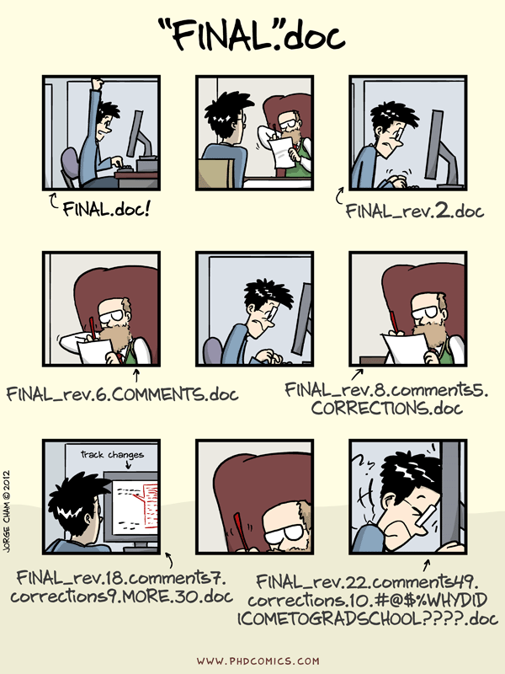
Source: http://www.phdcomics.com/comics/archive/phd101212s.gif
Notes:
Does this look familiar? Of course it does. We’ve all been subject, willingly and not, to this exercise.
You start off with good intentions, creating one document. But you need feedback, you have collaborators, or at some point you want to try out a new idea and make a copy of your document with that name.
Automated version control can get you out of this situation by letting us work on the same file but create unique versions in which only the changes are stored. We’ll get into this more in a bit. But first you might be saying to yourself, but these idiots should have been using Microsoft track changes!
Well, Microsoft Word does have track changes, but that’s just for Word documents, and I’ve seen plenty of examples where track change documents still get renamed by people. Google Docs does indeed have version history, but, again, you’re in a single silo’d context of Google Docs.
A version control system is file agnostic.
So, let’s take a closer look at how version control systems handle changes
Next slide ->

Slide 4

Changes Saved Sequentially
Notes:
Version control systems start with a base version of the document and then save just the changes you made at each step of the way, as well as important metadata about those changes, such as who made them.
You can think of it as a tape: if you rewind the tape and start at the base document, then you can play back each change and end up with your latest version. Contrast this with the kind of workflow we saw on the previous slide, where each new named copy of the file is a complete copy. This significantly saves a ton of space!
Next slide ->

Slide 5
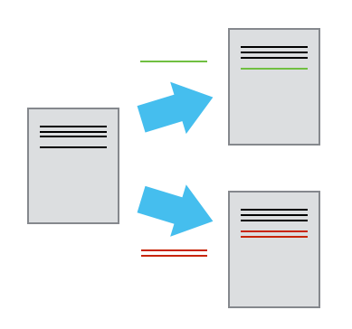
Divergent Versions
Notes:
Once you think of changes as separate from the document itself, you can then think about “playing back” different sets of changes onto the base document and getting different versions of the document.
For example, two users can make independent sets of changes based on the same document.
Next slide ->

Slide 6
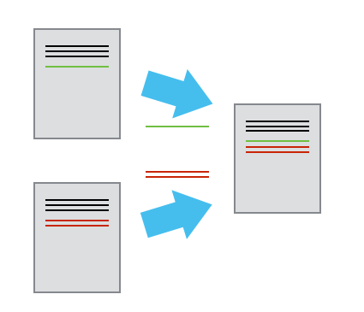
Merging
Notes:
If and when you and your collaborator want to merge work work back together, you can even try to play two sets of changes onto the same base document
If your changes are independent (separate areas of a file in this case) they can be merged back into a single document. If they’re in the exact same area of the document, then you can still merge the changes back in, but you’ll have to pick which of the changes you want. Git has tools to help you do this.
Next slide ->

Slide 7
Brief Glossary
Version Control - A tool for managing changes to a set of files. Each set of changes creates a new commit of the files; the version control system allows users to recover old commits reliably, and helps manage conflicting changes made by different users.
Commit - To record the current state of a set of files (a change set) in a version control repository
Repository - A storage area where a version control system stores the full history of commits of a project and information about who changed what, when.
Merge - To reconcile two sets of changes to a repository
Notes:
That was a lot!
Ok, so to circle back before we start on the command line, I always find it helpful to make sure we’re all speaking the same language. Everyone is used to coming into a new environment where people are using crazy acronyms and terms that are highly domain specific. I mean we work in a Library for god sakes. So, here are some terms and definitions we’re going to use going forward.
A version control system is a tool that keeps track of these changes for us and helps us version and merge our files. It allows you to decide which changes make up the next version, called a commit, and keeps useful metadata about them. The complete history of commits for a particular project and their metadata make up a repository. Repositories can be kept in sync across different computers facilitating collaboration among different people.
Questions?
Next slide ->

Slide 8
Getting Started
Here are two common ways to start a project and use git for version control.
Fork an existing GitHub project and clone it to your local system.
Create a local git repository.
Let’s try them both out!
Notes:
Both examples will be based on the TIER Documentation Protocol. This protocol provides a template for assembling the code, data, and documentation that comprise an empirical research project. Learn more about it at https://www.haverford.edu/project-tier/protocol-v2.
A GitHub repository is available at https://github.com/ProjectTIER/ProjectTIER_R.
Back to slides (Setting up Git) ->

Slide 9
Forking and Cloning a GitHub project
Log in to your GitHub account.
Navigate to https://github.com/ProjectTIER/ProjectTIER_R
Click the Fork button (upper right corner of the page)
Wait for the project to fork to your Github account
Click the Settings button and rename the project.
Use the Download or Clone button and copy the clone link.
Open a shell e.g. Terminal in MacOSX or Git-bash in Windows and give this command:
git clone https://github.com/YOUR_ACCOUNT/YOUR_PROJECT.git
Notes:
The GitHub interface also allows the creation of teams for collaborative development. A detailed explanation of the mechanics of collaboration is outside the scope of this tutorial, but is well documented in various sources.

Slide 10
Committing a Change
Use cd to navigate to your project folder:
cd YOUR_PROJECT
Edit the README.md file (use nano, notepad, etc.) to replace the content with the following text:
#Project TIER Framework Demo
Then give these commands to commit your change:
git add README.md
git commit -m “Modified project readme file”

Slide 11
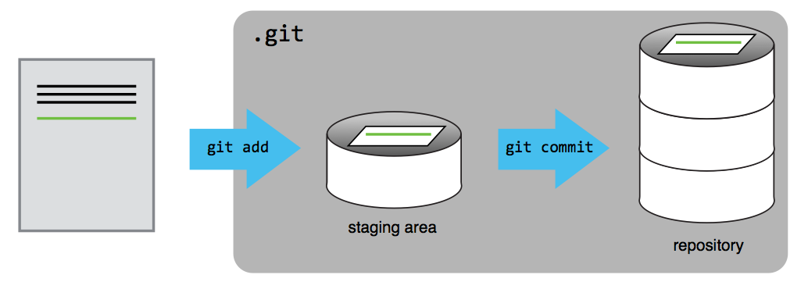
Git Staging Area
Notes:
You might think it’s a bit annoying to have to add your changes to a staging area, then commit them
A commit represents a set of work, changes/additions/deletions of one to many files.
Many times, you might find yourself touching several files as part of a change. Maybe you update a script and the documentation in a README, for example.
Add files as you work on this, then when everything is ready, you can review (using our favorite git status) and then commit
Shopping cart metaphor. Your staging area is the shopping cart. You walk the aisles in the store and grab what you need for the dinner you’re making tonight. But at the end of all that shopping, you checkout once for everything
Also lets you catch mistakes and fix them, or make additional changes, before you commit
Let’s look at another example with multiple files (next slide)

Slide 12
Challenge
Find the “command-files” directory in your project.
Using nano, notepad, etc. create a file called datacleaning.R
The file should contain a single comment line like this:
# datacleaning.R - created by YOUR NAME on TODAY’S DATE.
Run the following command and note the output.
git status
Add and commit the file to git.

Slide 13
Pushing to GitHub
You can commit your change to GitHub using this command.
git push origin
(You’ll need to authenticate in order to push to GitHub)
Check GitHub to see your change!

Slide 14
Create a Local Repository
It’s also possible to create a local repository from the command line. Let’s build a TIER Project from scratch (be sure to navigate out of the project directory you just created):
mkdir ProjectTIER_demo_2
cd ProjectTIER_demo_2
mkdir -p original-data-and-metadata/metadata/supplements
mkdir original-data-and-metadata/original-data
mkdir -p processing-and-analysis/analysis-data
mkdir processing-and-analysis/command-files
mkdir processing-and-analysis/importable-data
echo “#Project TIER Framework Demo” >> README.md

Slide 15
Initialize and Commit to git
We’ll create the default README file and.
git init
git add .
git commit -m “Initial commit”
If you choose to do so, you may push the project to GitHub. You’ll need to create an new, empty repository on GitHub, copy the url, then run these commands:
git remote add origin REMOTE_REPO_URL
git push -u origin master

Slide 16
Using Git: Alternatives to Command Line
GitK: https://git-scm.com/docs/gitk
Github Desktop: https://desktop.github.com/
Atlassian SourceTree: https://www.atlassian.com/software/sourcetree
GUI Clients: https://git-scm.com/downloads/guis
Editor Git Integrations: R Studio, Atom, Sublime Text, Vim, emacs, ...
Notes:
In this class, we’ve taught you the core basic usage of git on the command line, since the rest of the work we’re doing is primarily in a command line workflow.
That said, I know many of you do not use the command line on a daily basis, though hopefully you will consider it more going forward.
There are more user-friendly desktop client applications that you can use instead of the command line.
Github Desktop is great if you’re working with Github, highly recommended.
SourceTree is built by Atlassian. If you use their Stash product, you may decide you prefer SourceTree as there are some nice Stash integrations.
Most editors also have some form of Git integration now as well. It’s worth looking to see if you have a favorite editor.

Slide 17
Resources
http://swcarpentry.github.io/git-novice
http://swcarpentry.github.io/git-novice/reference.html
https://services.github.com/kit/downloads/github-git-cheat-sheet.pdf
http://ndpsoftware.com/git-cheatsheet.html
https://help.github.com/articles/dealing-with-line-endings/#platform-all
https://help.github.com/articles/generating-an-ssh-key/ (SSH keys)
https://www.youtube.com/watch?v=dBSHLb1B8sw (Deep Dive into Git)
https://git-man-page-generator.lokaltog.net/ (Fun with Git Docs)

